Slide 1
Thermochemistry
Chapter 6

Slide 2
Contents
Getting Started: Some Terminology
Heat, Energy, Work
Heats of Reaction and Calorimetry
The First Law of Thermodynamics
Heats of Reaction: ΔU and ΔH
The Indirect Determination of ΔH: Hess’s Law
Standard Enthalpies of Formation

Slide 3
Thermochemistry is the branch of chemistry
concerned with the heat effects that accompany
chemical reactions
In thermochemistry, we will study the absorption or
release of heat energy that accompanies chemical
reactions
The heat change is measured by a calorimeter
Heat: Heat is the transfer of thermal energy from one
object to another as a result of temperature difference
between the two

Slide 4
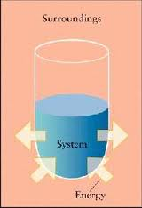
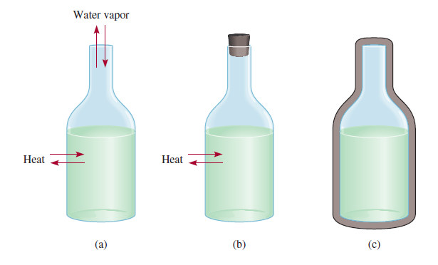
System and Surroundings
Hot
Water
Hot
Water
Hot
Water
Hot
Water
Open
System
Closed
System
Isolated
System
System: The specific part of the universe that is of
interest to us.
Surroundings: Rest of the universe outside the system.

Slide 5
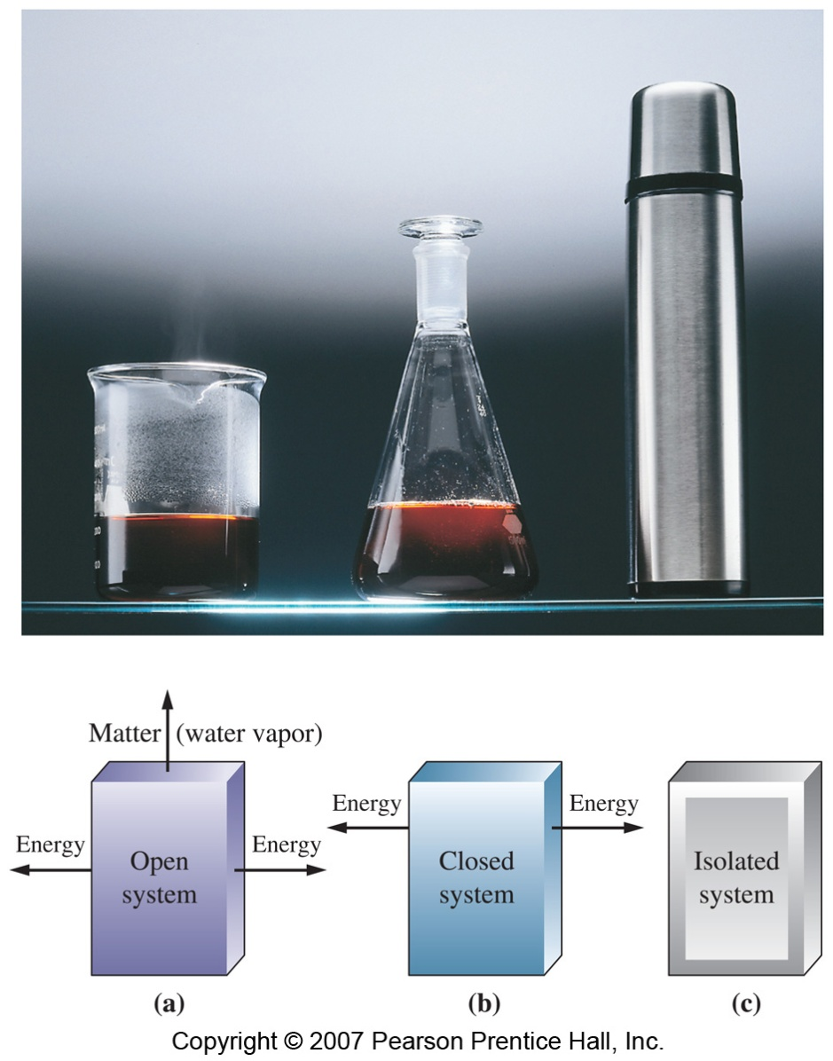
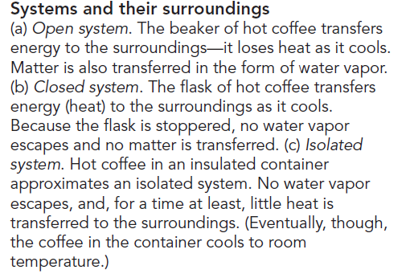
(a)
(b)
(c)
Open system: An open system freely exchanges energy and matter with its surroundings
Closed system: A closed system can exchange energy, but not matter, with its surroundings
Isolated system: An isolated system does not interact with its surroundings

Slide 6
Terminology
Energy, U
The capacity to do work.
Kinetic Energy, e_{K}
Energy produced by a moving object.
Potential Energy, V
- Potential energy is the stored energy. This energy is stored in an object because of its height or in a molecule because of the reactions it might undergo
Work, w
Work is the product of a force and the distance
through which the force is applied.
SI unit of work: joul

Slide 7
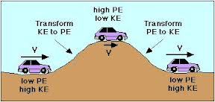

Slide 8
Kinetic Energy:
Amount of kinetic energy in a moving object with mass m and
velocity, v is given by:
2
1
m
e_{k} =
mv²
[e_{k} ] =
kg
= J
2
s
Potential energy: Potential energy due to gravity is
PE = mgh
Work:
w = F x d
= (m x a) x d
SI unit of work, w = joul (J)
1 J = 1 kg m² S⁻²
Notes:
Click 1 exposes the work formulae
Click 2 exposes the units of work, notice they are the same as the units of kinetic energy

Slide 9
Internal energy:
Internal energy of the system is defined as the sum
of all kinetic and potential energies for every molecule
or ion in the system.
Internal energy would be conserved and remain
constant throughout the reaction

Slide 10
Thermal energy:
Thermal energy is the kinetic energy associated with the random motion of atoms and molecules
Thermal energy is proportional to the temperature of system
Thermal energy can be calculated from temperature measurements
Thermal energy of a system also depends on the number of particles present

Slide 11
Heat
Heat is the amount of energy transferred between a system and its surroundings as a result of a temperature difference.
Heat “flows” from hotter to colder.
Heat transfer cause a change in temperature and can also change the state of a matter
The amount of heat transferred during a reaction can be measured with a device called calorimeter

Slide 12
Units of Heat
Calorie (cal)
The quantity of heat required to change the temperature of one gram of water by one degree Celsius.
Joule (J)
SI unit for heat is Joul
1 cal = 4.184 J

Slide 13
Heat Capacity (C)
The quantity of heat required to change the temperature of a system by one degree is called the heat capacity of the system.
Where q is the quantity of heat transferred and ΔT is the temperature change (ΔT = T_{final} - T_{initial})
Molar heat capacity (C_{m}):
Amount of heat necessary to raise the temperature of 1mol of a substance by 1 °C.
Heat, q =
CΔT

Slide 14
Specific heat capacity or specific heat (sp ht)
The amount of heat necessary to raise the temperature of 1 g of a substance by 1 °C
At 25 °C, the specific heat of water is 4.18 J g⁻¹ °C⁻¹
The amount of heat necessary to raise the temperature of a given object, then, is the specific heat times the mass of the object times the rise in temperature
Quantity of heat, q = (specific heat) x (mass of substance) x ΔT
heat capacity = C
q = C X ΔT

Slide 15
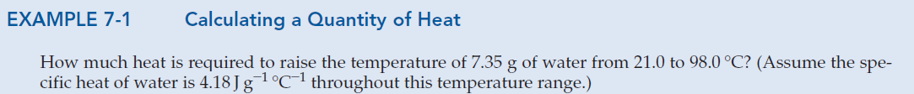
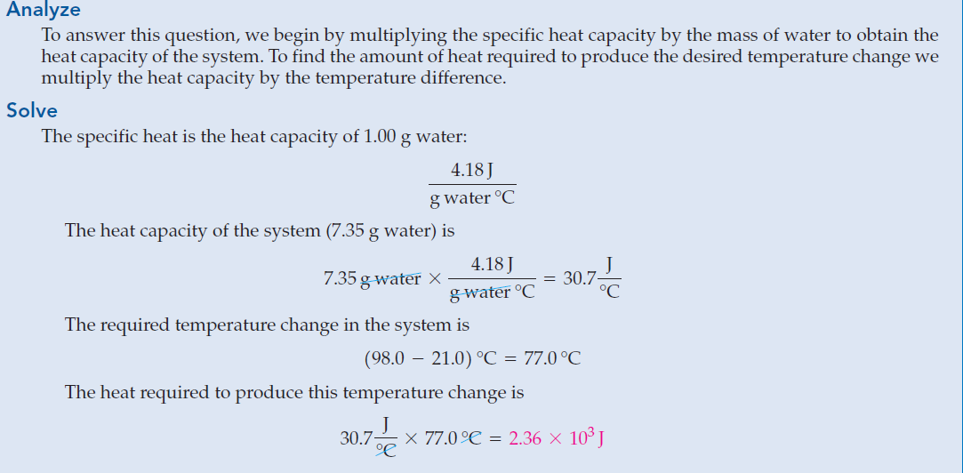

Slide 16
Law of Conservation of Energy
- required to calculate quantities of heat
In interactions between a system and its surroundings the total energy remains constant— energy is neither created nor destroyed.
q_{system} + q_{surroundings} = 0
q_{system} = -q_{surroundings}
Thus, heat gained by a system is lost by its surroundings

Slide 17
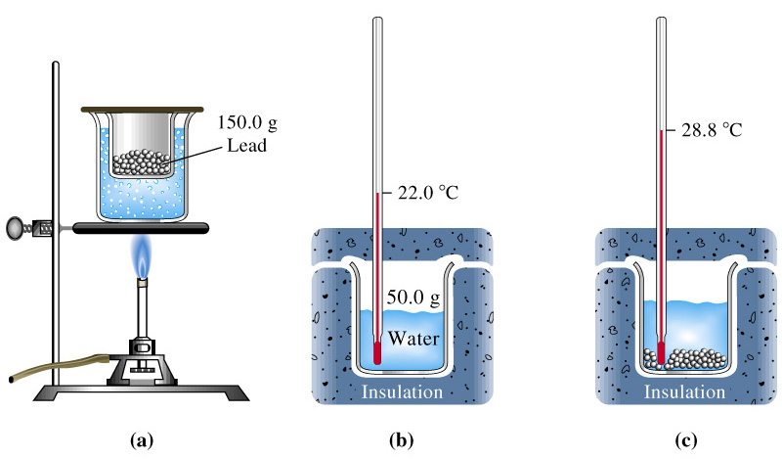
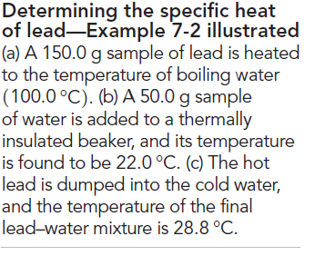
Determination of Specific Heat of lead
calculate the specific heat of lead

Slide 18
Solution of Example
Determining Specific Heat from Experimental Data.
.
Consider, lead is the system and water is the surroundings
q_{lead} = -q_{water}
q_{water} = m x c x ΔT = (50.0 g)(4.184 J/g °C)(28.8 - 22.0)°C
q_{water} = 1.4x10³ J
q_{lead} = -1.4x10³ J = m x c x ΔT = (150.0 g) x (c_{lead}) x (28.8 - 100.0)°C
c_{lead} = 0.13 Jg⁻¹°C⁻¹

